Slide 1
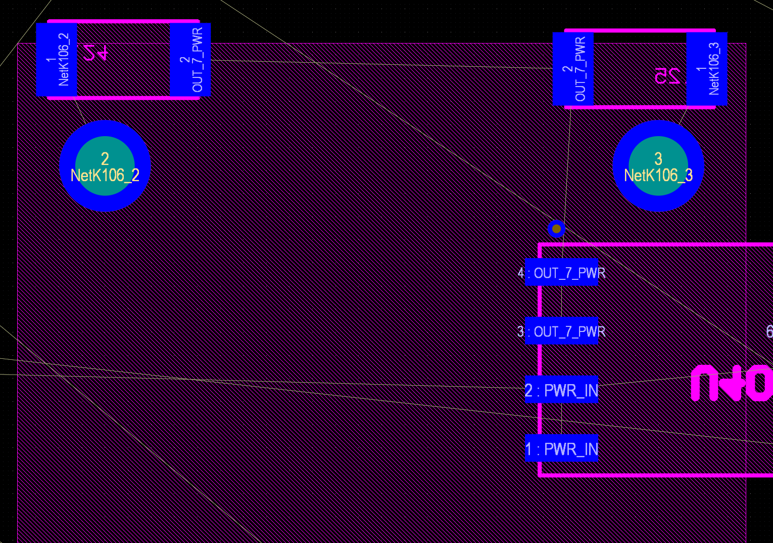
System with multiple 15A outputs
Fault currents perhaps ~ 30A
Copper busbars for handling the current in most cases.
Problem with connection to output relay

Slide 2
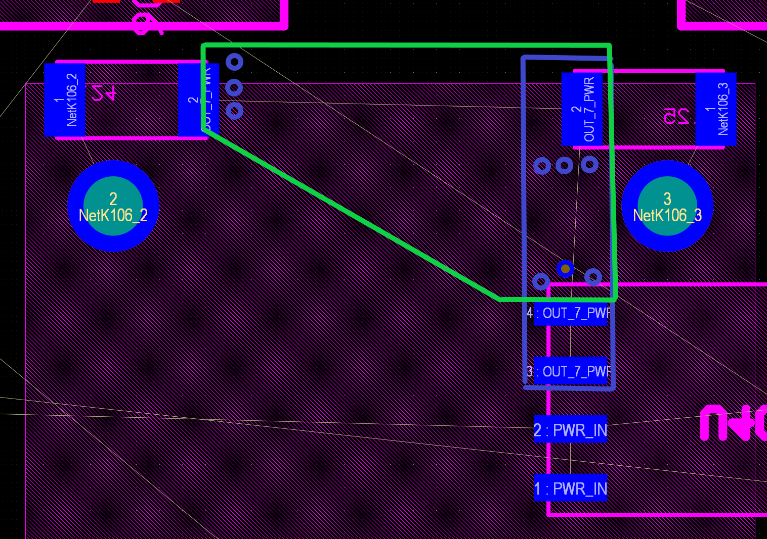
Standard via current capacity an issue. Calculation shows min 11 needed – Space!
Is copper filled via an option?
0,4/0,2 via is desired. Can go to 0,6/03 probably. One should carry at least 4A. (Temp rise 20C)

